Slide 1
Worksheet: Beliefs survey
1. Rate how much you agree with each of these statements:
If a young person notices someone doing or saying something that could upset someone else, they should generally just mind their own business
We all have a responsibility to care about other people.
In life people should stand up for each other more.
Offending someone is ok if it was meant to be a joke.
------------------------------------
Strongly disagree Strongly agree
------------------------------------
Strongly disagree Strongly agree
------------------------------------
Strongly disagree Strongly agree
------------------------------------
Strongly disagree Strongly agree
2. After this lesson, how confident do you feel about your ability to be a positive bystander (in general)?
------------------------------------
Not confident at all Very confident
Being a positive bystander

Slide 2
Worksheet: Which rights are being broken?
Every child has the right to: | Mubeen is wondering whether he might be bisexual. In his relationships and sex education, the teacher talks about flirting, romance and sexual activities as if they always take place between boys and girls (never between boys, or between girls). | Shauna is regularly teased and made fun of by people in her year at school because of her taste in music and her look. | Tina and Ben are girl- and boyfriend (in year 11). Ben shared some personal stuff and told Tina he loved her in a messaging chat one evening. Last week Tina showed some of her friends his messages and they’ve been teasing him ever since.
An identity
Privacy
Live from (and be protected from) all forms of abuse and exploitation
Think and believe what they choose, as long as they are not stopping other people from enjoying their rights
An education
Relax, play and take part in a range of cultural and artistic activities
Meet with other children and to join groups & organisations, as long as this does not stop other people from enjoying their rights
Express their views, feelings & wishes in all matters affecting them and to have their views considered and taken seriously
Rights in relationships

Slide 3
Worksheet 1: Which principles aren’t being followed?
1) Jules is at a house party, chatting to Kat, who is flirting with her. Jules picks up (correctly) that Kat is interested in her. Jules is not attracted to Kat but is thinking about kissing her and seeing how far they might go, because Kat is really popular.
2) When Zakia and Luca were going out, Zakia sent Luca a nude. A few months later, Zakia ended the relationship with Luca. Luca is thinking about showing his friends Zakia’s nude because he feels bitter and wants to somehow ‘get back’ at her.
3) Glen and Charlie are flirting at a house party. They are both very drunk, at one point Charlie falls over and starts talking about wanting to go home. Glen feels that if he doesn’t make a move now, the opportunity will be missed.
Trust | Respect | Enjoyment | Honesty
Trust | Respect | Enjoyment | Honesty
Trust | Respect | Enjoyment | Honesty
Healthy sexual experiences

Slide 4
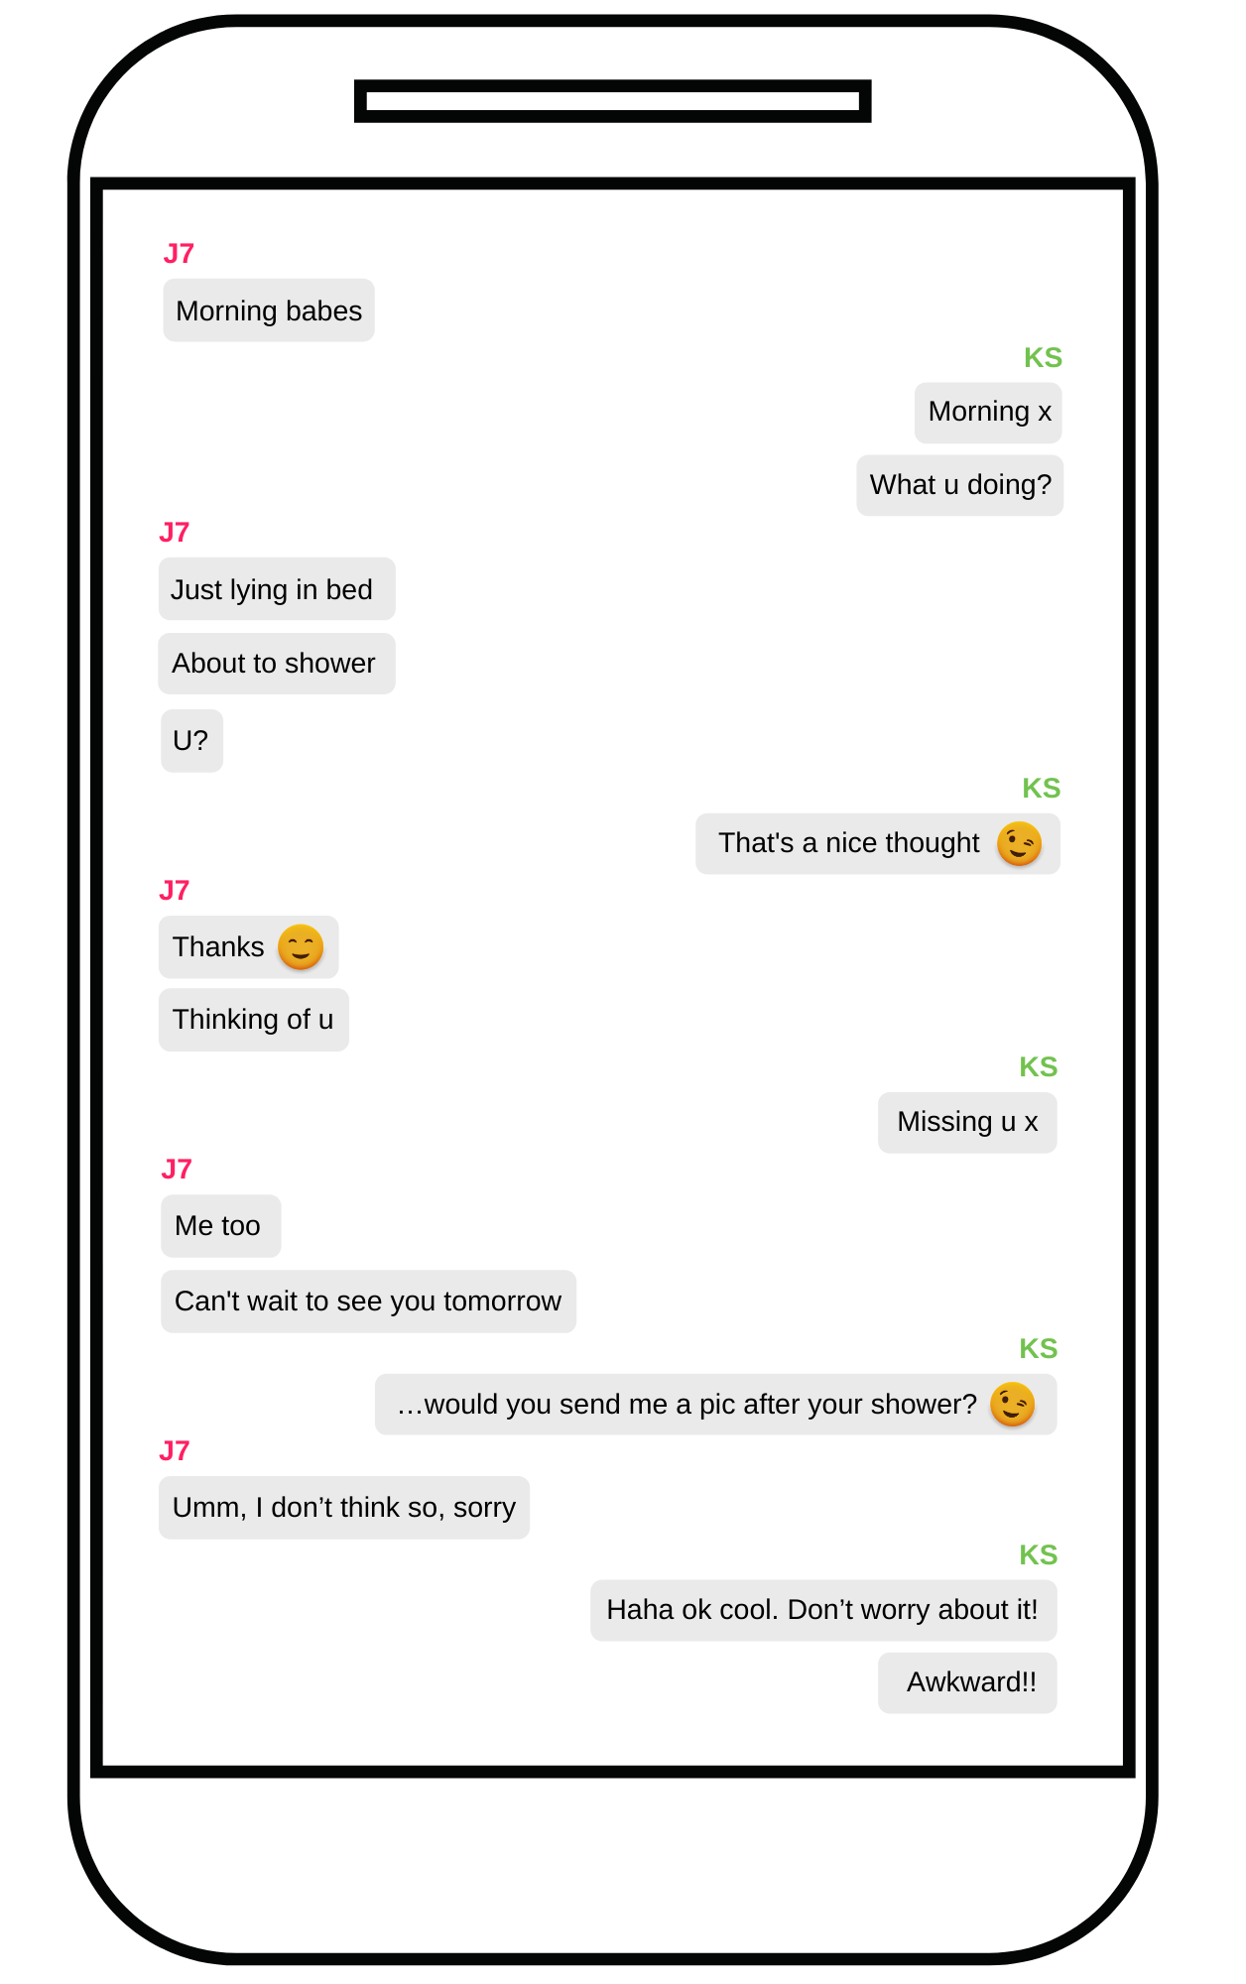
Worksheet 2: Chat log
Healthy sexual experiences

Slide 5
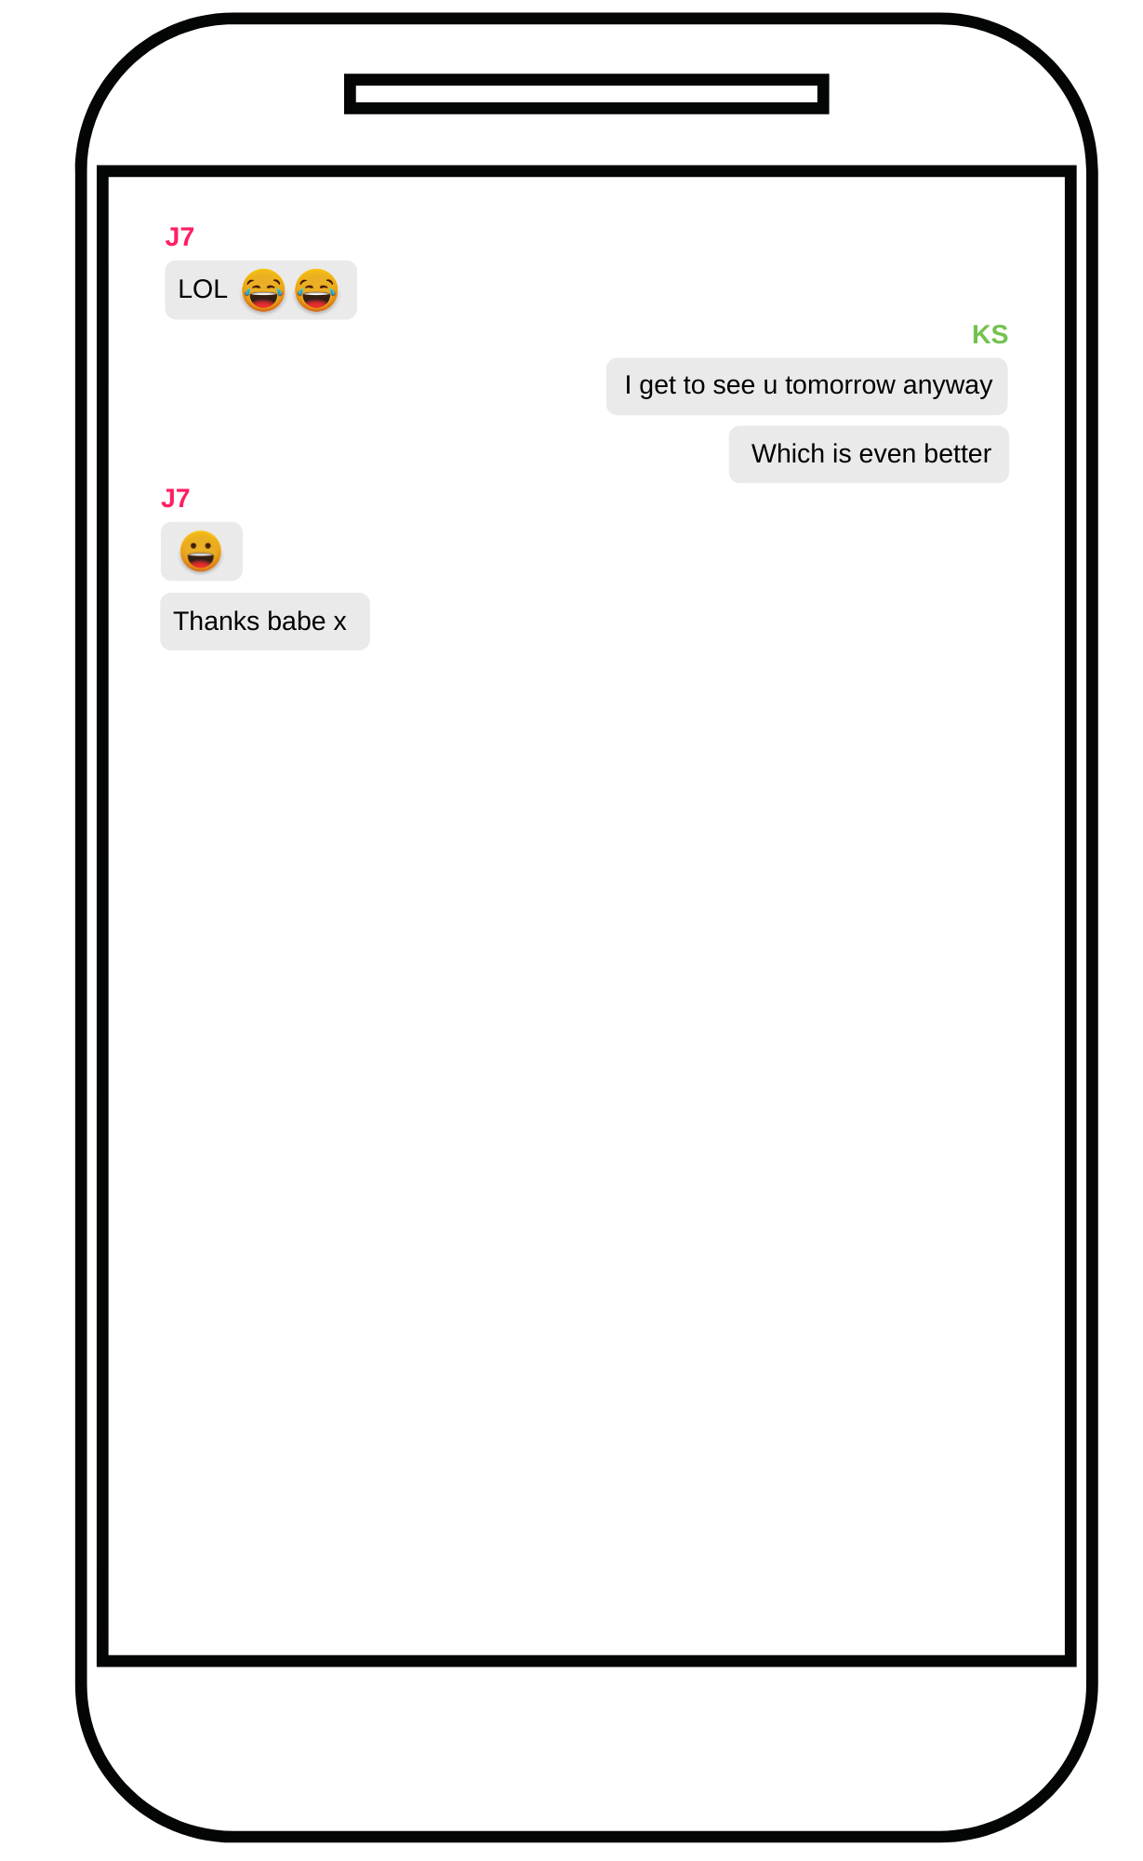
Worksheet 2: Chat log
Healthy sexual experiences

Slide 6
Handout: Support services
CEOP Education provides information for young people about relationships and sex online. Thinkuknow.co.uk/11_18/
Brook provide young people under 25 with sexual health services and support and advice. Their website has information on contraception, pregnancy, sexually transmitted infections (STIs) and more. Brook.org.uk
Childline is a free, private, and confidential service where young people can talk about anything. Whatever the worry, Childline can be contacted online, on the phone, anytime. The Childline website also has lots of helpful advice, games, and activities. Childline.co.uk.
The NHS have information about the sexual health services available in the UK. This includes contraception, pregnancy, abortion, and sexually transmitted infections (STIs) services. They also have a tool where you can search for your nearest sexual health clinic. Nhs.uk/nhs-services/sexual-health-services/guide-to-sexual-health.
Healthy sexual experiences

